Slide 1


Protein Synthesis

Slide 2

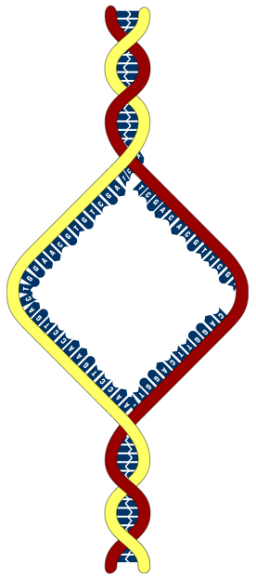
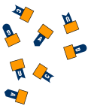

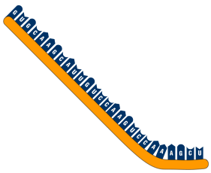

Transcription
DNA
A mRNA strand is formed using the DNA molecule as the template.
Free nucleotides with bases complementary to the DNA are joined together by the enzyme RNA polymerase.
Free nucleotides
used to construct
the mRNA strand
Single-armed
chromosome as found in non-dividing cell
RNA polymerase enzyme
Template strand of DNA contains the information for the construction of a functional mRNA product (e.g. a protein)
Direction of synthesis
Coding strand
The two strands of DNA coil up into a double helix
Formation of a single strand of mRNA that is complementary to the template strand (therefore the same “message” as the coding strand)

Slide 3
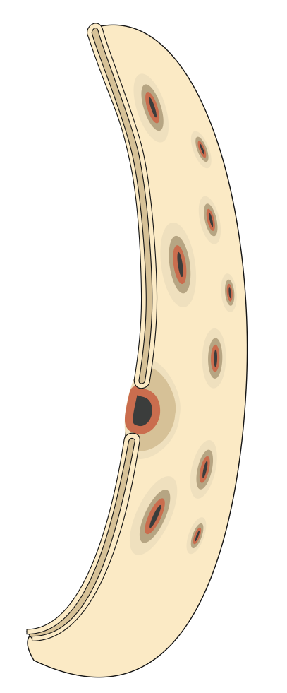
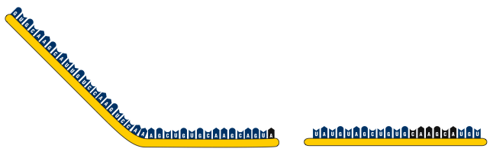


Movement of mRNA
In eukaryotic cells, the two main steps in protein synthesis occur in separate compartments: transcription in the nucleus and translation in the cytoplasm.
mRNA moves out of the nucleus, to the cytoplasm, through pores in the nuclear membrane.
In prokaryotic cells, there is no nucleus, and the chromosome is in direct contact with the cytoplasm, and protein synthesis can begin even while the DNA is being transcribed.
Ribosomes
mRNA
Nuclear pore through
which the mRNA passes
into the cytoplasm
Nucleus
Cytoplasm

Slide 4
mRNA Codes for Amino Acids
Read second letter here
Second Letter
Read third letter here
Read first letter here
 | U |  | C |  | A |  | G
U | UUU | Phe | UCU | Ser | UAU | Tyr | UGU | Cys | U
 | UUC | Phe | UCC | Ser | UAC | Tyr | UGC | Cys | C
 | UUA | Leu | UCA | Ser | UAA | STOP | UGA | STOP | A
 | UUG | Leu | UCG | Ser | UAG | STOP | UGG | Try | G
C | CUU | Leu | CCU | Pro | CAU | His | CGU | Arg | U
 | CUC | Leu | CCC | Pro | CAC | His | CGC | Arg | C
 | CUA | Leu | CCA | Pro | CAA | Gln | CGA | Arg | A
 | CUG | Leu | CCG | Pro | CAG | Gln | CGG | Arg | G
A | AUU | Iso | ACU | Thr | AAU | Asn | AGU | Ser | U
 | AUC | Iso | ACC | Thr | AAC | Asn | AGC | Ser | C
 | AUA | Iso | ACA | Thr | AAA | Lys | AGA | Arg | A
 | AUG | Met | ACG | Thr | AAG | Lys | AGG | Arg | G
G | GUU | Val | GCU | Ala | GAU | Asp | GGU | Gly | U
 | GUC | Val | GCC | Ala | GAC | Asp | GGC | Gly | C
 | GUA | Val | GCA | Ala | GAA | Glu | GGA | Gly | A
 | GUG | Val | GCG | Ala | GAG | Glu | GGG | Gly | G
First Letter
Third Letter

Slide 5
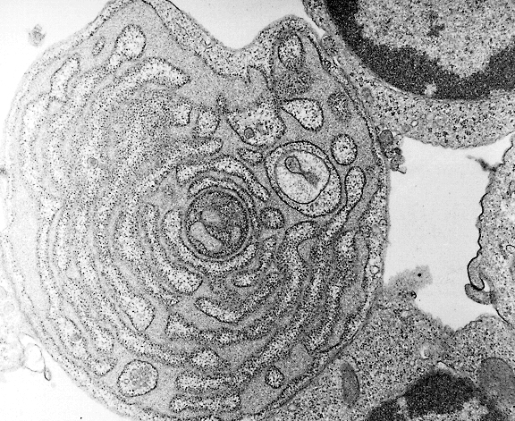
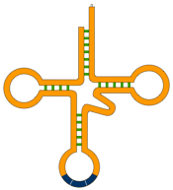

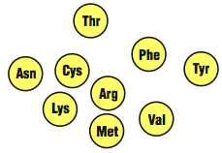
Translation
Translation is the process of building a polypeptide chain from amino acids, guided by the sequence of codons on the mRNA.
Structures involved in translation:
Messenger RNA molecules (mRNA) carries the code from the DNA that will be translated into an amino acid sequence.
Transfer RNA molecules (tRNA) transport amino acids to their correct position on the mRNA strand.
Ribosomes provide the environment for tRNA attachment and amino acid linkage.
Amino acids from which the polypeptides are constructed.
The speckled appearance of the rough endoplasmic reticulum is the result of ribosomes bound to the membrane surface.
mRNA
Ribosomes
tRNA
Amino acids

Slide 6

Ribosomes & tRNA
Ribosome
Comprises two subunits in which there are grooves where the mRNA strand and polypeptide chain fit in.
The ribosomal subunits are constructed of protein and ribosomal RNA (rRNA).
The subunits form a functional unit only when they attach to a mRNA molecule.
tRNA molecule
There is a specific tRNA molecule and anticodon for each type of codon.
The anticodon is the site of the 3-base sequence that 'recognizes' and matches up with the codon on the mRNA molecule.
Ribosome
Large subunit
Small subunit
Amino acid attachment site
Ribosome attachment point
The 3-base sequence of the anticodon is complementary to the codon on the mRNA molecule
Anticodon
Transfer RNA molecule

Slide 7

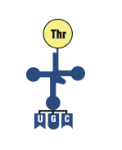
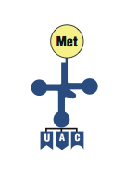

Translation: Initiation
The first initiation stage of translation brings together mRNA, a tRNA bearing the first amino acid of a polypeptide, and the two ribosomal subunits.
The small ribosomal sub-unit attaches to a specific nucleotide sequence on the mRNA strand just ‘upstream’ the initiation codon (AUG) where translation will start. The initiator tRNA, carrying methionine, attaches to the initiator codon.
The large ribosomal sub-unit binds to complete the protein-synthesizing complex.
Initiator tRNA
Activated Thr-tRNA
Small ribosomal unit attaches
Large ribosomal unit attaches to form a functional ribosomal protein-synthesizing complex
mRNA
P
site
A
site
Ribosomes move in this direction
Ribosome

Slide 8


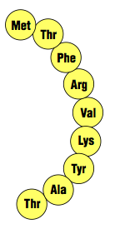




Translation: Elongation
In the elongation stage of translation, amino acids are added one by one by tRNAs as the ribosome moves along the mRNA. There are three steps:
The correct tRNA binds to the A site on the ribosome.
A peptide bond forms between adjacent amino acids.
The tRNA at the P site is released. The tRNA at the A site, now attached to the growing polypeptide, moves to the P site and the ribosome advances by one codon. This step requires energy.
Activated Tyr-tRNA
Growing polypeptide
Unloaded Thr-tRNA
mRNA
5’
P site
A site

Slide 9
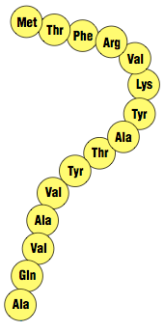


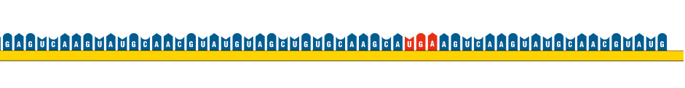
Translation: Termination
The final stage of protein synthesis (termination) occurs when the ribosome reaches a stop codon.
A release factor binds to the stop codon and hydrolyzes the completed polypeptide from the tRNA, releasing the polypeptide from the ribosome.
Release factor
Completed polypeptide
Completed polypeptide is released
The ribosomal units then fall apart so that they can be recycled.

Slide 10


Overview of Translation
Activating
Lys-tRNA
Polypeptide chain in an advanced stage of synthesis
Activated Tyr-tRNA
Growing polypeptide
Unloaded Thr-tRNA
Start codon
Ribosome
mRNA
Ribosomes moving in this direction

Slide 11









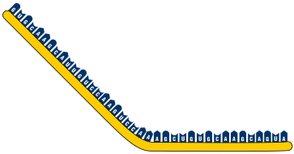




Structures Involved With Protein Synthesis
c mRNA molecule
Nuclear membrane
Free amino acids
DNA molecule
Free nucleotides
Unloaded tRNA
RNA polymerase
Polypeptide chain
Ribosome
mRNA molecule
Nuclear pores
Cytoplasm
Nucleus
Label structures A-J

Slide 12
c mRNA molecule
Processes Involved With Protein Synthesis
Adding nucleotides to create mRNA
tRNA recharged with amino acid
Unloaded tRNA leaves translation complex
Unwinding DNA molecule
RNA polymerase
tRNA with amino acid is drawn into the ribosome
DNA molecule rewinds
mRNA moves to cytoplasm
tRNA adds amino acid to growing polypeptide
Nucleus
Cytoplasm

